Slide 1
TREC 2022 FAIR RANKING TRACK OVERVIEW
Michael Ekstrand
Boise State University
Graham McDonald
University of Glasgow
Amifa Raj
Boise State University
Isaac Johnson
Wikimedia Foundation

Slide 2




Query
Ranking
Documents
Protected Attributes
Exposure
Attention
User
Do relevant articles associated with protected attributes get fair exposure?

Slide 3
Fair Ranking Track 2022 vs Previous Years
2019-2020
Domain: Scholarly articles
Tasks:
Task 1: Ad-hoc retrieval
Task 2: Re-ranking
2021
Domain: Wikimedia
Tasks: Ad-hoc retrieval
Task 1: Single ranking
Task 2: Stochastic ranking
2022
Same tasks & domain
New: many more dimensions! And intersectionality evaluation

Slide 4
Equal Expected Exposure
“given a fixed information need, no item should have an expected exposure more or less than any other item of the same relevance.”
F. Diaz, B. Mitra, M. D. Ekstrand, A. J. Biega, B. Carterette. Evaluating stochastic rankings with expected exposure. CIKM, 2020.

Slide 5
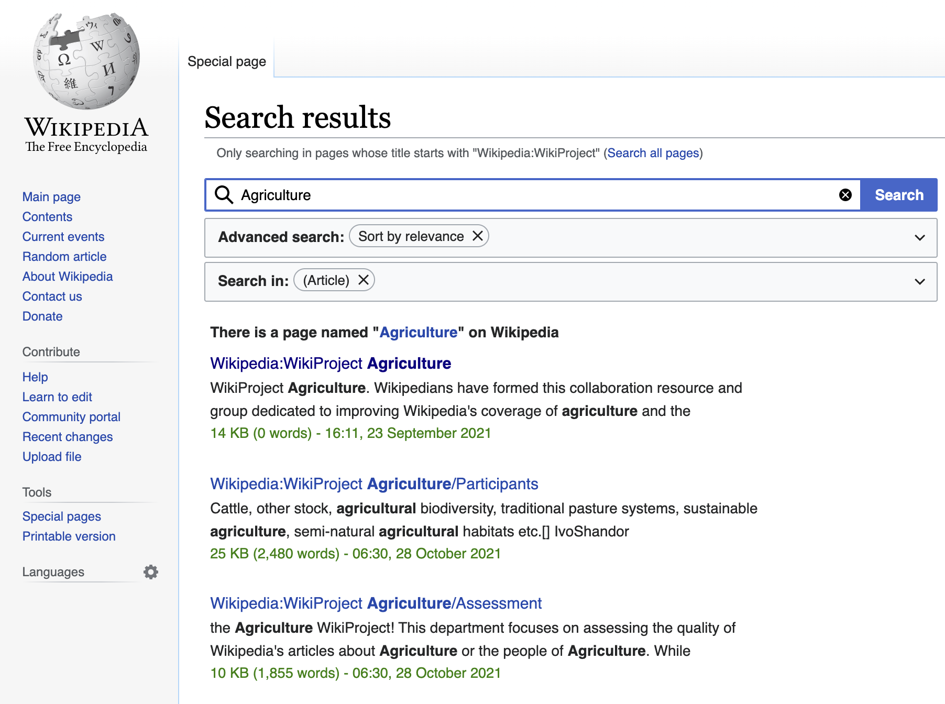
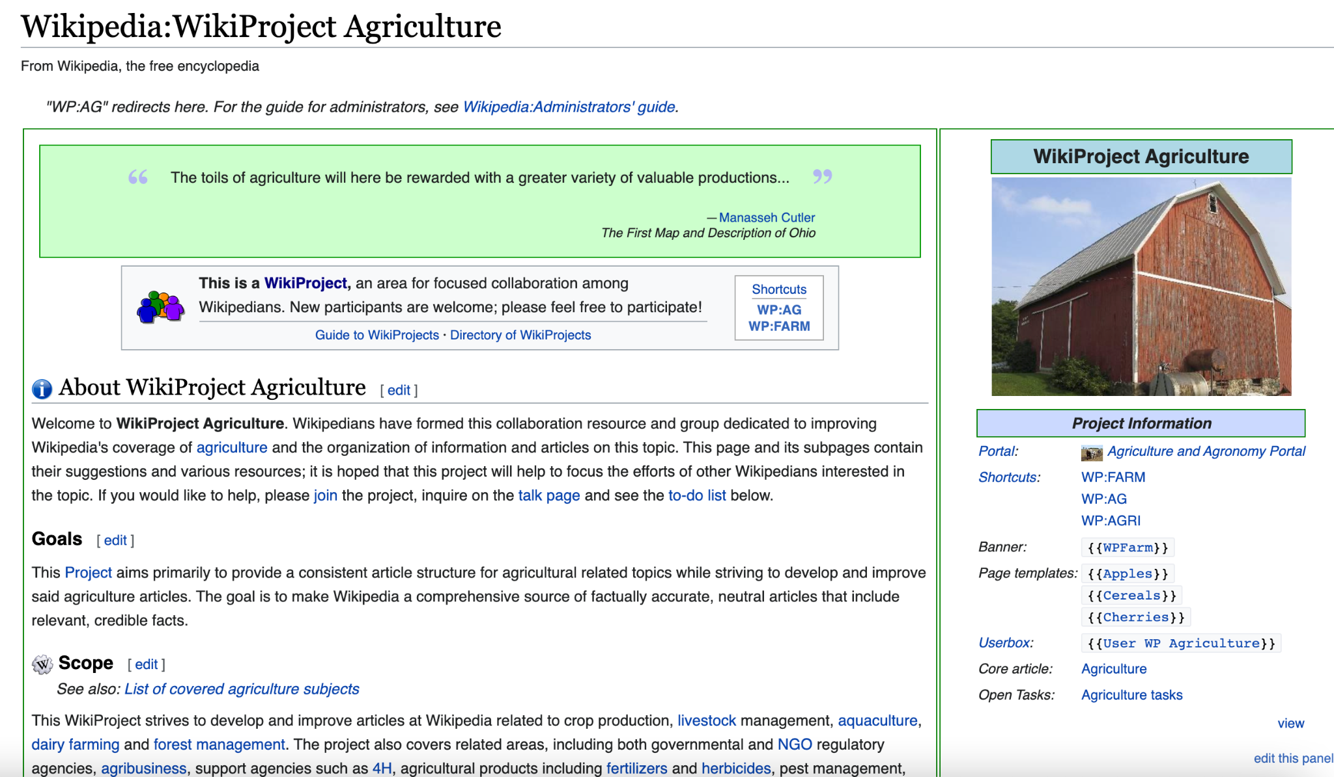
WikiProject

Slide 6
WikiProject
Wiki articles
Protected Attributes
Query
Ranking
Documents
Topic Query
Exposure
Attention
Co-ordinators/ Editors
User
Documents: A subset of English language Wikipedia articles
Query: Topic form WikiProject
Fairness Objective: Ensure groups of articles associated with protected attributes get fair exposure
Task: ad-hoc retrieval

Slide 7



Task 1
Use Case: Help Wikiproject coordinators in finding articles for editors.
Single ranking per query
Evaluated based on
Wiki articles
Topic Query
Ranking
Geographic
Demographic
Relevance Fairness
Images are from https://unsplash.com/

Slide 8
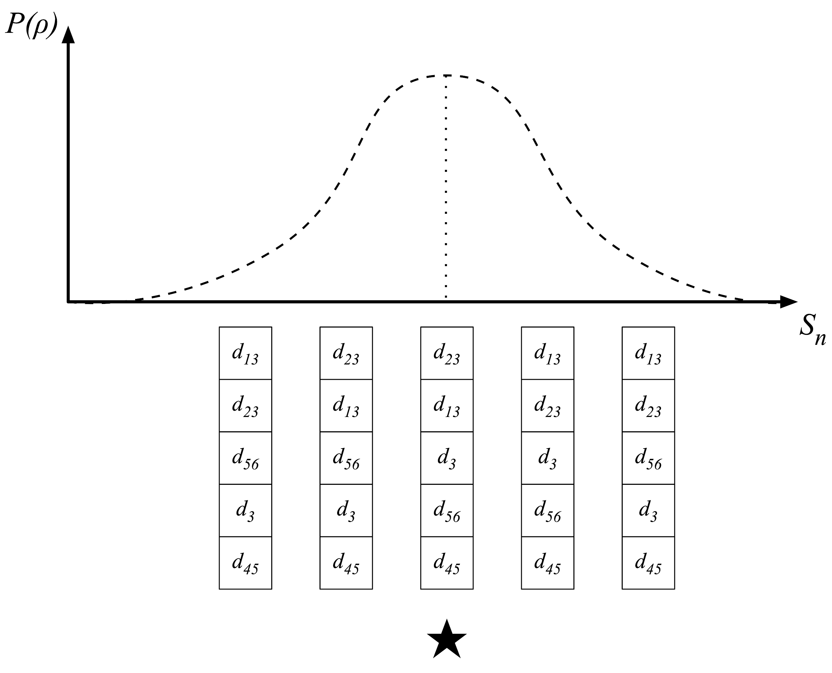

Task 2
Use Case: Help Wikiproject editors finding articles associated with a project (saved search)
Distribution over ranking
Evaluated based on
Topic Query
Ranking
Geographic
Demographic
Relevance Quality Fairness
Images are from https://unsplash.com/

Slide 9

We Provided
ID
Title
Keyword
Scope
Homepage
ID
Title
Url
Text
Quality
Geographic locations
Gender
Data
Full data for 8 dimensions (both train & eval)
WikiProject topic
English Wiki articles

Slide 10
Ranking Objectives
Relevant documents come before irrelevant documents
Fairness goal: Group exposure is fairly distributed according to the average of the distribution of relevant documents and the distribution of global population
Relevant documents are sorted in nonincreasing order of work needed (Task 2)
Articles that need more editing will be on top
For each query participants have to submit:
Task 1: single ranking consisting of 500 articles
Task 2: 100 rankings each consisting of 20 articles

Slide 11
Annotations
NIST assessors annotated the articles with binary relevance score.
Annotation were incomplete because:
Task 2 generates massive data (~700,000 article-topic pairs)
Incomplete articles and not having enough information
We obtained assessment through tiered-pooling
The first 20 items of all rankings for Task 1 (all queries)
The first 5 items of the first 25 rankings from every submission to Task 2 (about 75% of the queries).

Slide 12
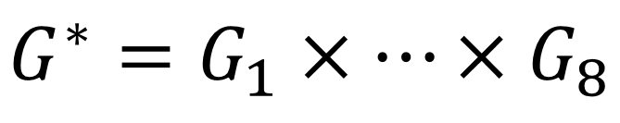
Evaluation Strategy
Fairness with respect to 8 dimensions simultaneously
“unknown” as a separate group where needed
11M total intersectional dimensions
Log discounting for attention weight
Measure exposure of group
Compare with target exposure

Slide 13
Target Exposure
Ranked list
Relevant set from Wikipedia
Wikipedia has well-documented bias
Imbalance in group distribution in topic relevance
No data on ideal distribution for any particular topic
...
Exposure vector
average
Global population
World population for geography
Equality for gender
No averaging for other attributes
Muldimensional: outer product of single dimensions

Slide 14
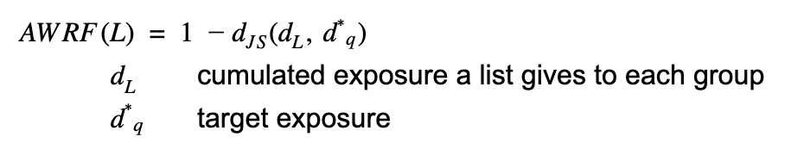
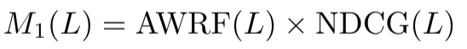
Metrics for Single Ranking
Relevance Metric: NDCG
Fair Ranking Metric: Attention Weighted Rank Fairness (AWRF)
Jensen -shannon divergence between target and given exposure
Combine fairness metric and relevance metric
P. Sapiezynski, W. Zeng, R. E Robertson, A. Mislove, and C. Wilson. WWW 2019

Slide 15
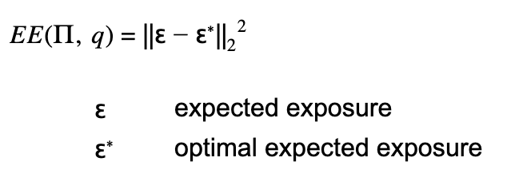
Fairness Metric for Stochastic Rankings
Expected Exposure Metric
π(ρ, q) = P(ρ,q)
π ranking policy
q user query
ρ document ranking
F. Diaz, B. Mitra, M. D. Ekstrand, A. J. Biega, B. Carterette. Evaluating stochastic rankings with expected exposure. CIKM, 2020.

Slide 16
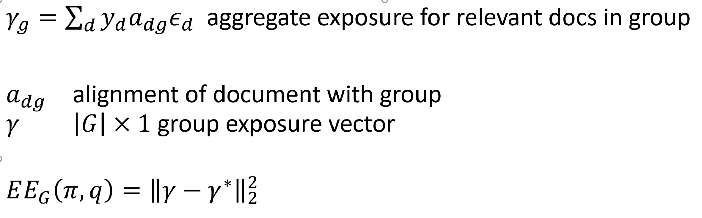
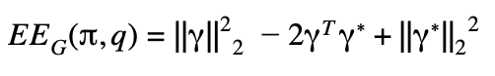
Fairness Metric for Stochastic Rankings
Expected Exposure Metric for Group Fairness
This is Expected Exposure Loss (EE-L)
Expected-Exposure Disparity (EE-D)
Expected-Exposure Relevance (EE-R)
F. Diaz, B. Mitra, M. D. Ekstrand, A. J. Biega, B. Carterette. Evaluating stochastic rankings with expected exposure. CIKM, 2020.

Slide 17
Submissions
5 Teams Participated:
We received
Submissions from 5 teams for Task 1 (27 runs total)
Submissions from 2 teams for Task 2 (11 runs total)
Approaches
Task 1
Explicit Diversification
Implicit diversification
Data Fusion
Constraint-based approaches
Relevance-only baselines
Task 2
Multi-Armed Bandits
Colbert-based
Tailored Diversification
Relevance-only

Slide 18
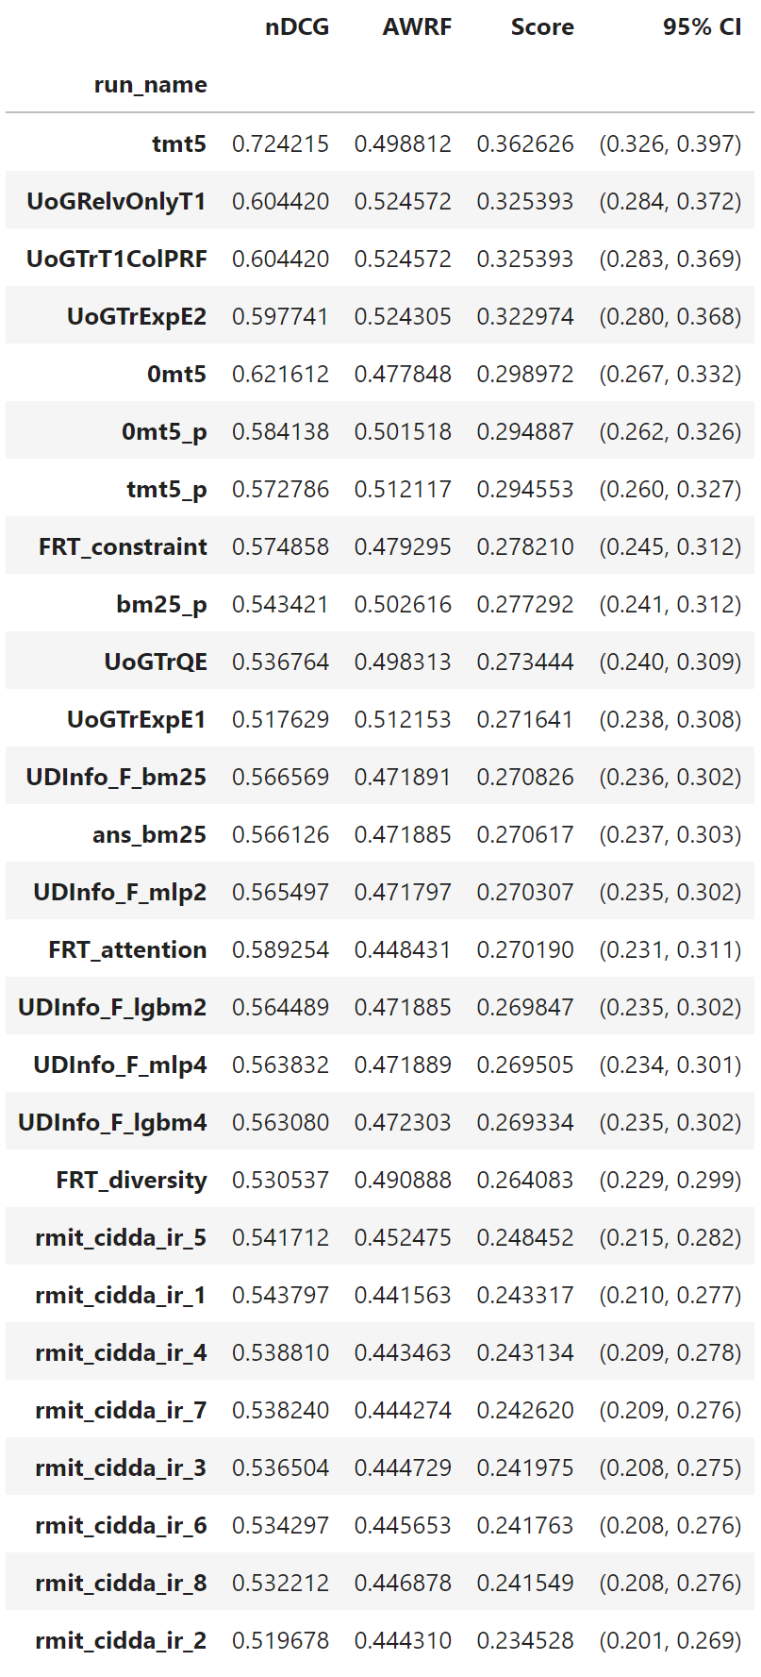
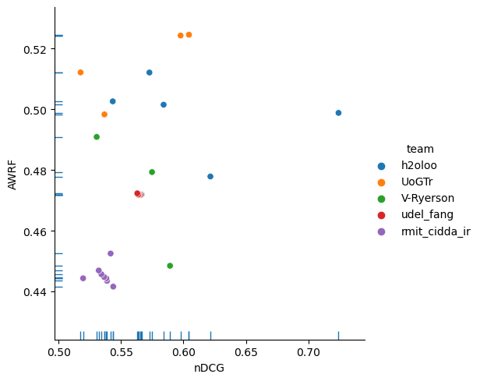
Result: Task 1
Higher score is better

Slide 19
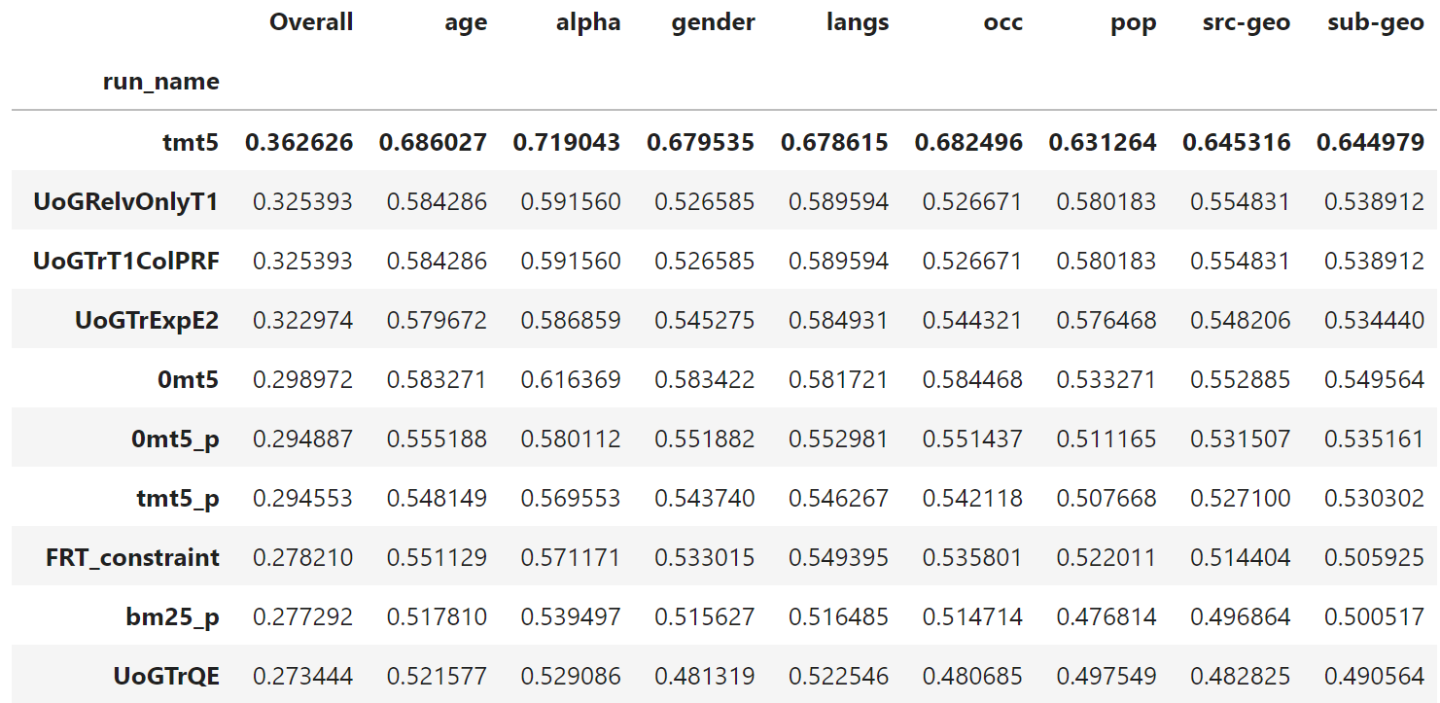
Task 1 - Individual Attributes
More on this tomorrow…

Slide 20
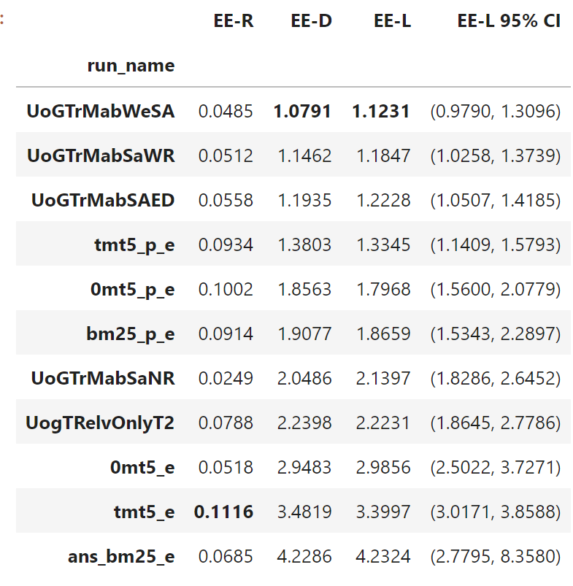
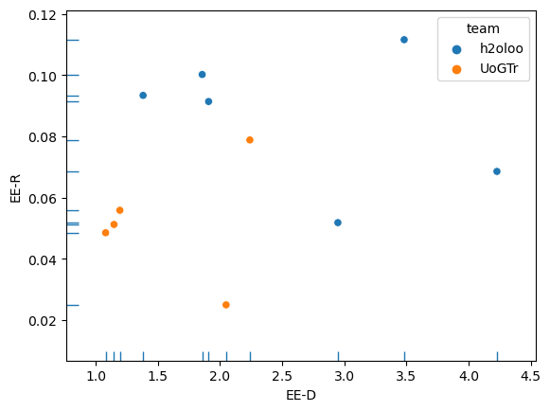
Result: Task 2
Lower EE-D is better; higher EE-R is better
Lower EE-L is better

Slide 21
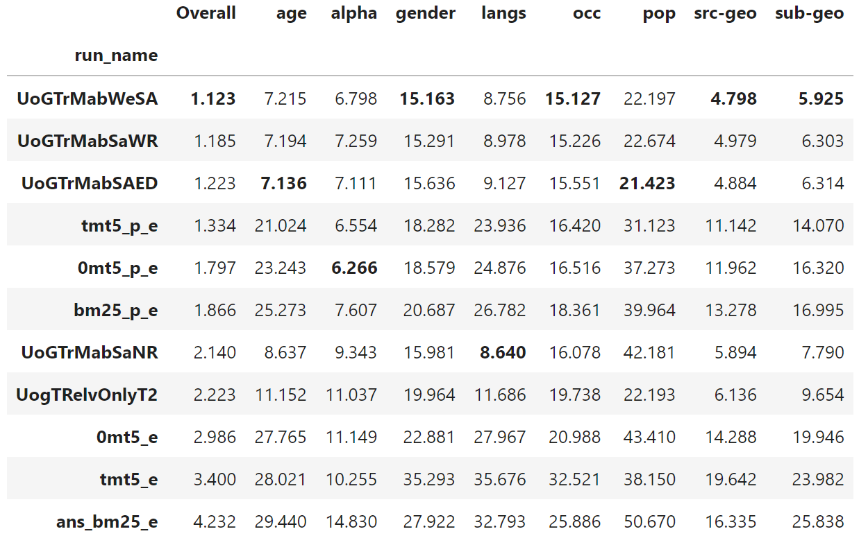
Task 2 - Individual Attributes

Slide 22
Limitations
Fairness Criteria
Geography: incomplete location information
Gender: possibility of misgendering
Multidimensional fairness counts all attributes as independent
Task Definition
Doesn’t consider missing or deleted articles
There are more important protected attributes

Slide 23
Lessons Learned
Increasing dimensions significantly increases complexity of computations, especially for determining target distributions
Final space was 11M dimensions!
Many points have no instances
Memory-intensive computations
Performing well on multidimensions does not always equal good performance on individual dimensions.
Fair Ranking Track Plenary Session is on November 15th (9am - 12pm)

Slide 24

Thanks
grant IIS 17-51278

